Slide 1
ANDROID
Sec:8
Eng. Rasha Sleem

Slide 2
Fragment
It represents a behavior or a portion of user
interface in an Activity.
It has its own lifecycle, receives its own input
events, and which you can add or remove while the
activity is running.
You can combine multiple fragments in a single
activity to build a multi-pane UI and reuse a
fragment in multiple activities.

Slide 3
A fragment must always be embedded in an activity and the fragment's lifecycle is directly affected by the host activity's lifecycle.
– when the activity is paused, so are all fragments in it.
– when the activity is destroyed, so are all fragments.
– However, while an activity is running (it is in the
resumed lifecycle state), you can manipulate
each fragment independently, such as add or
remove them.

Slide 4
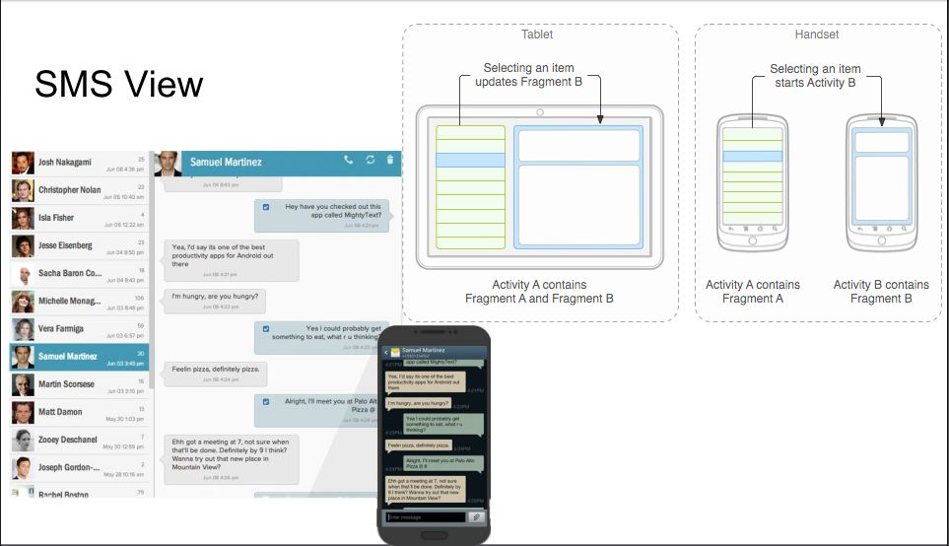
Example

Slide 5
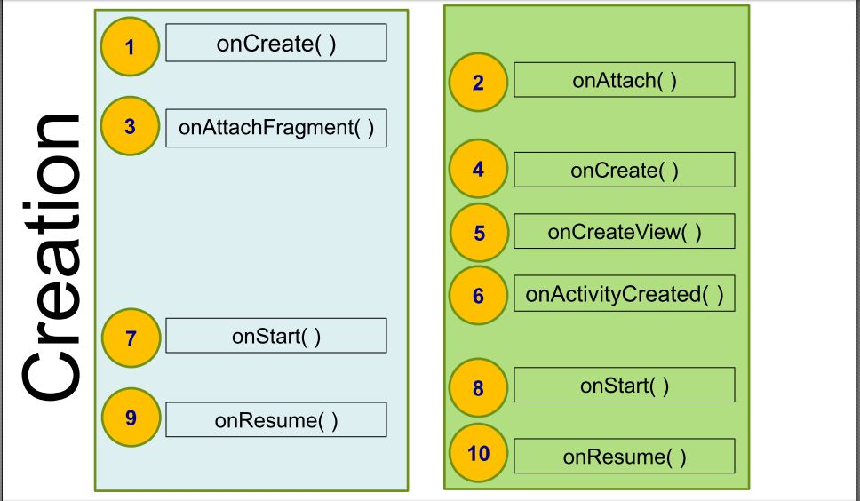
Activity vs. Fragment lifecycle

Slide 6
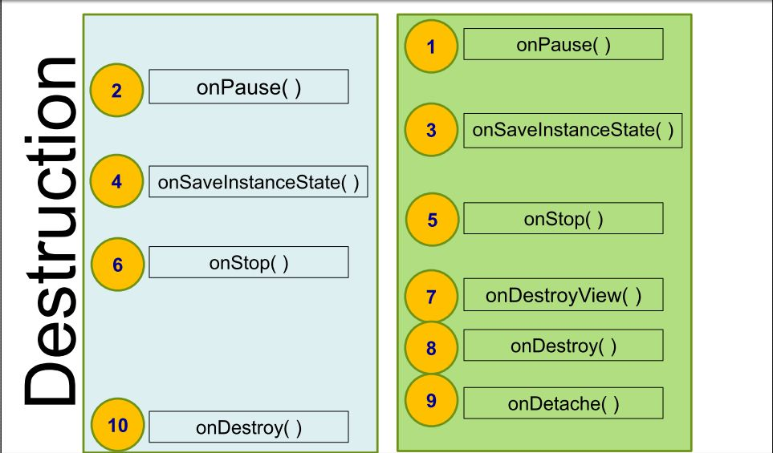

Slide 7
Adding fragment to activity
Two Ways to add Fragments to an Activity:
1. Add <Fragment> to the XML Layout
2. Add Fragment in Java

Slide 8
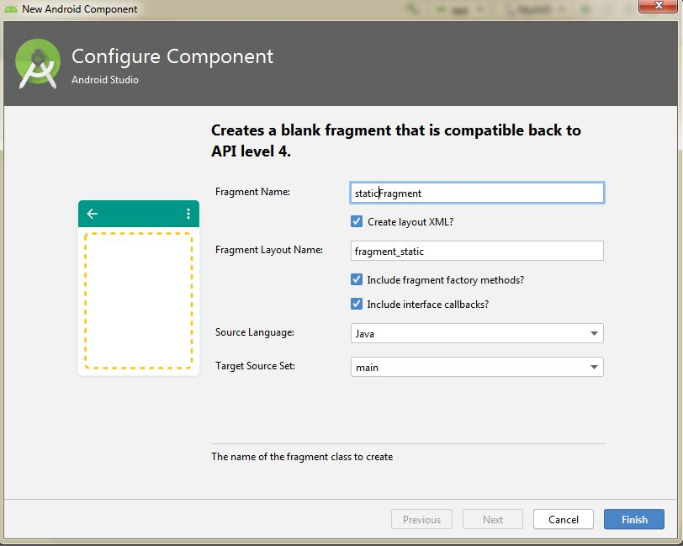
1-Static Fragment
app →new →fragment →blank fragment

Slide 9
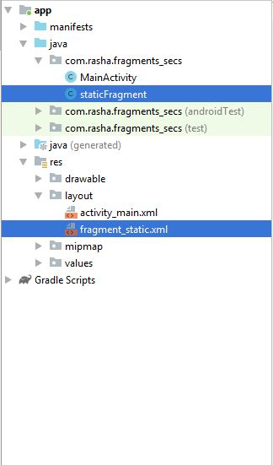

Slide 10
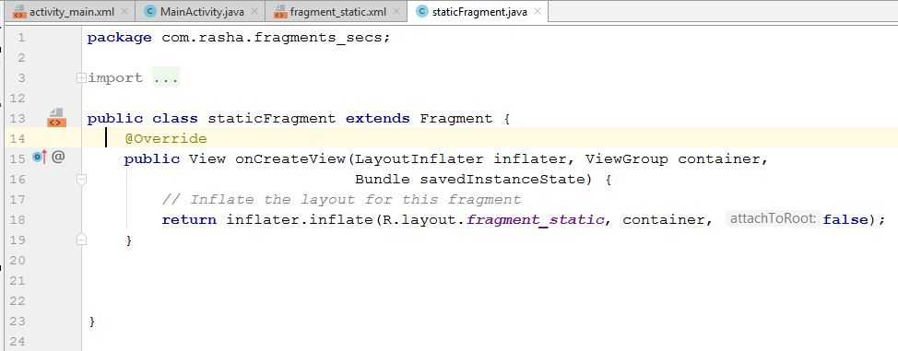
staticFragment.java

Slide 11
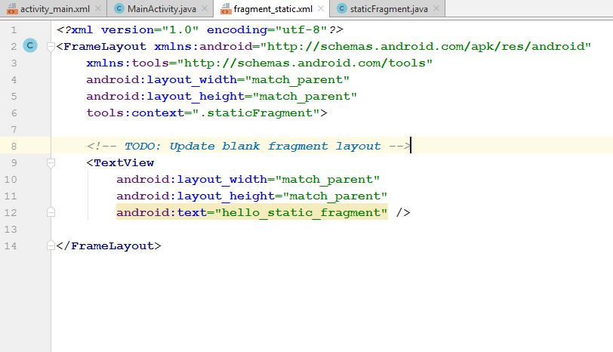
Fragment_static.xml

Slide 12
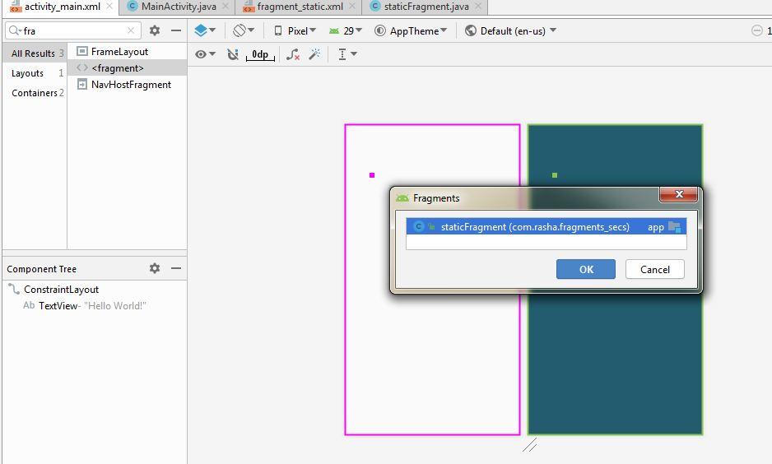
Adding fragment to activity

Slide 13
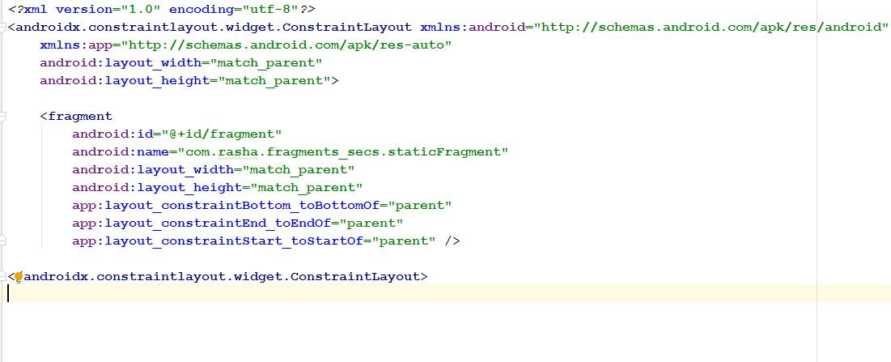
activity_main.xml

Slide 14
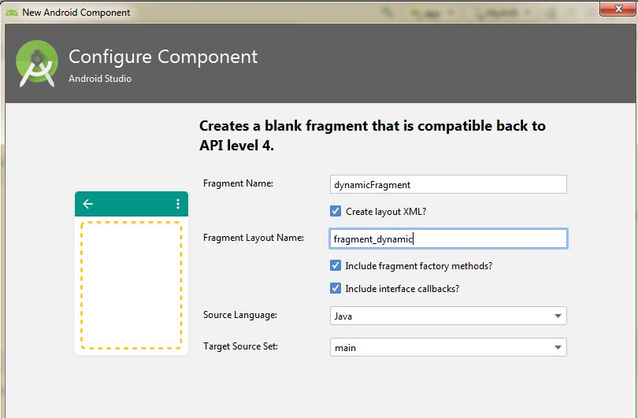
2-Dynamic Fragment
app →new →fragment →blank fragment

Slide 15
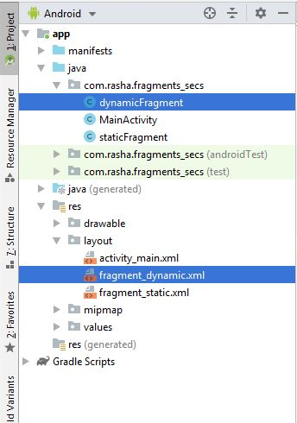

Slide 16
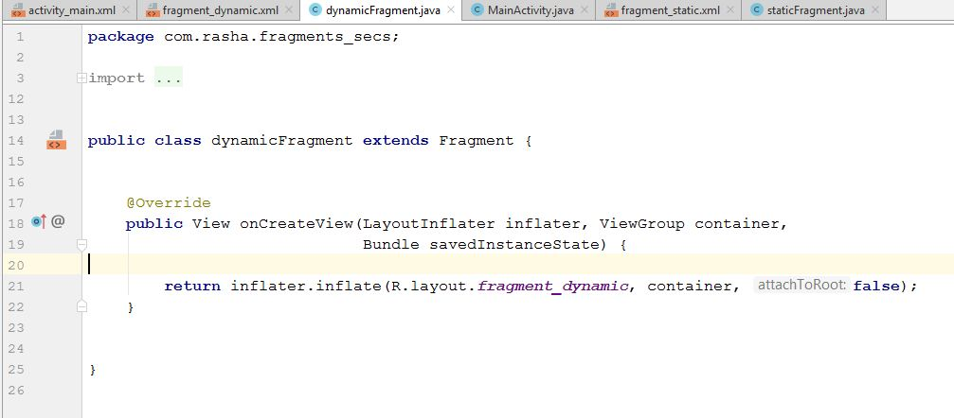
Dynamic_fragment.java

Slide 17
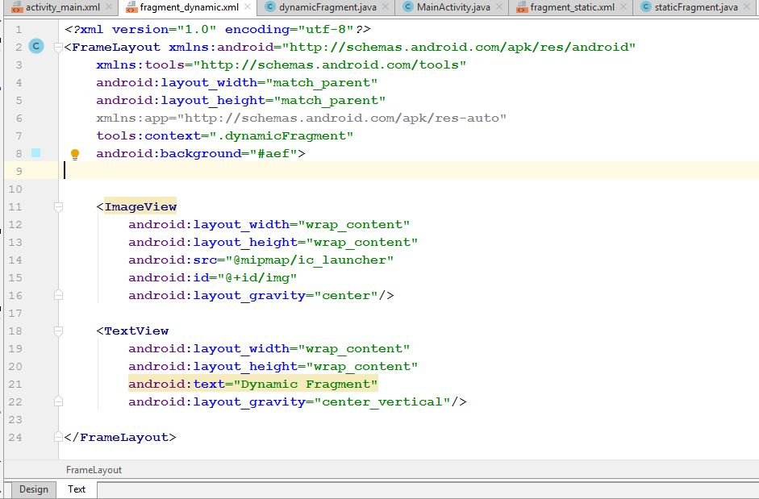
Fragmnet_dynamic.xml

Slide 18
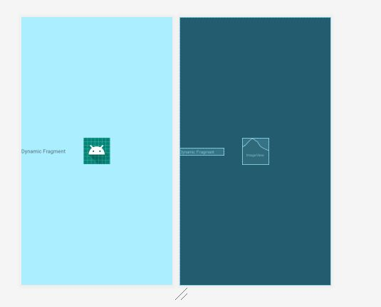

Slide 19
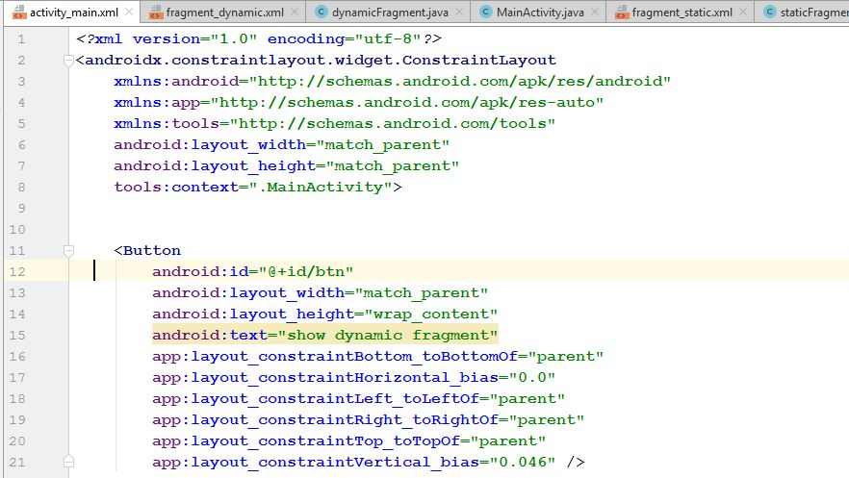
activity_main.xml

Slide 20
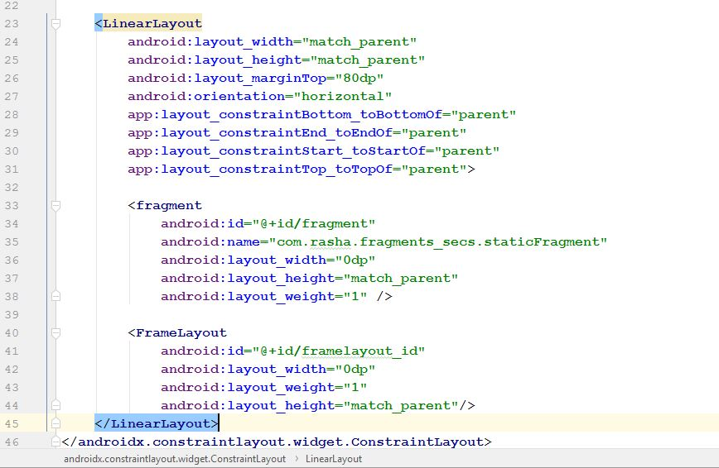

Slide 21
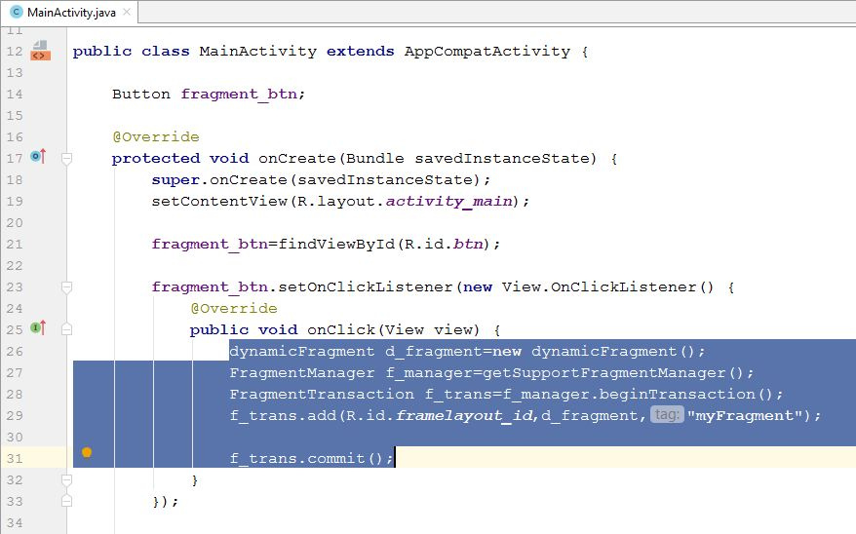
Main_activity.java

Slide 22
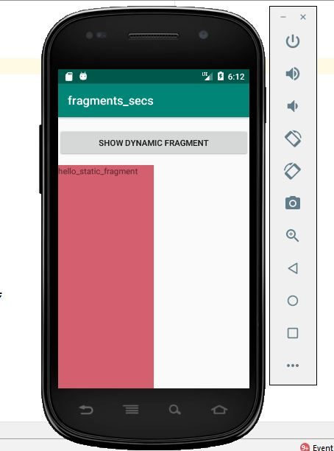

Slide 23
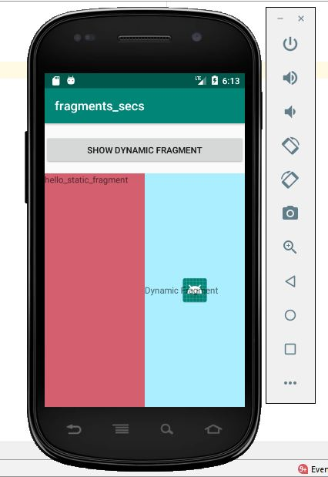

Slide 24
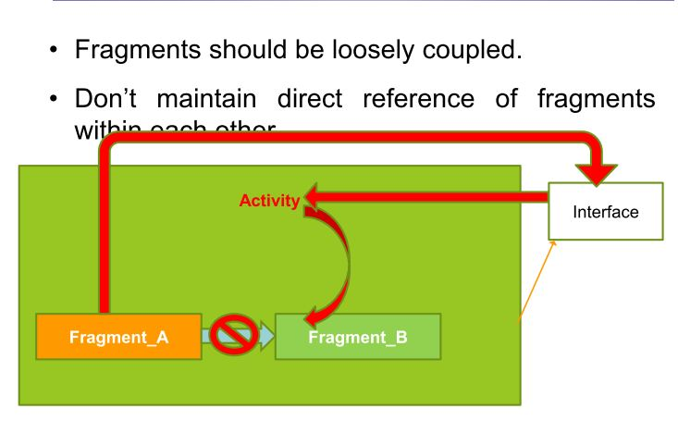
Inter fragment communication

Slide 25
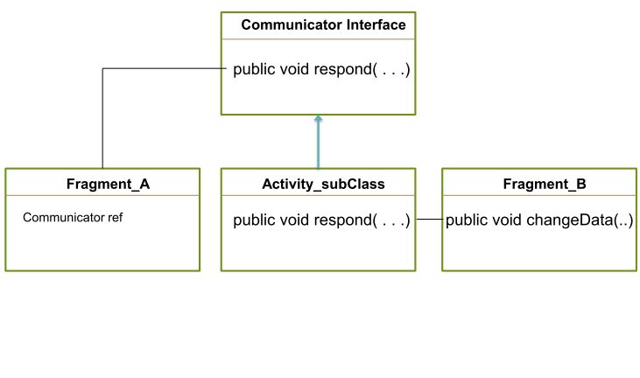
Communicator design pattern

